Slide 1

ML Talks – Session4
Linear Regression

Slide 2
Introduction to Regression
Linear Regression is the most famous machine learning algorithm and it is a statistical method to carry out predictive analysis. But before we jump into understanding Linear regression, let’s understand what regression is.

Slide 3
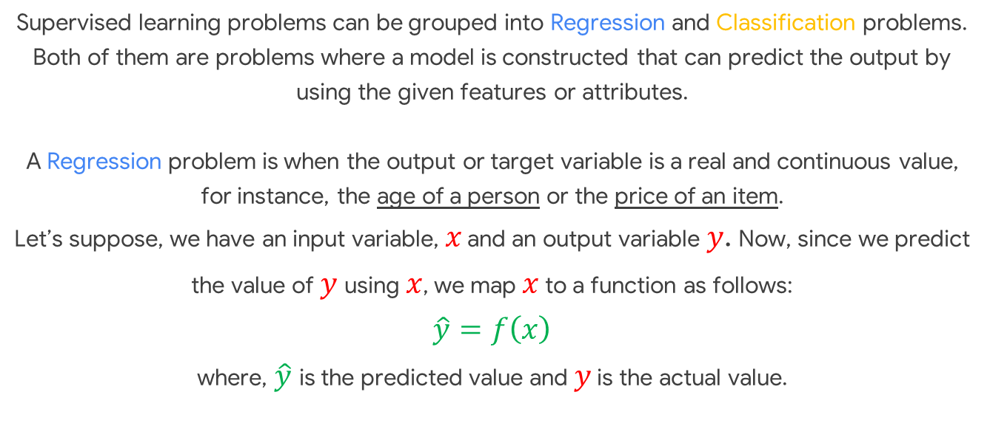
Supervised learning problems can be grouped into Regression and Classification problems. Both of them are problems where a model is constructed that can predict the output by using the given features or attributes. A Regression problem is when the output or target variable is a real and continuous value, for instance, the age of a person or the price of an item. Let’s suppose, we have an input variable, $x$ and an output variable $y$. Now, since we predict the value of $y$ using $x$, we map $x$ to a function as follows: $$\hat{y}=f\left(x\right)$$ where, $\hat{y}$ is the predicted value and $y$ is the actual value.

Slide 4
Linear Regression
Now that we know what regression is, let’s try to understand what Linear Regression is and how does it work.

Slide 5
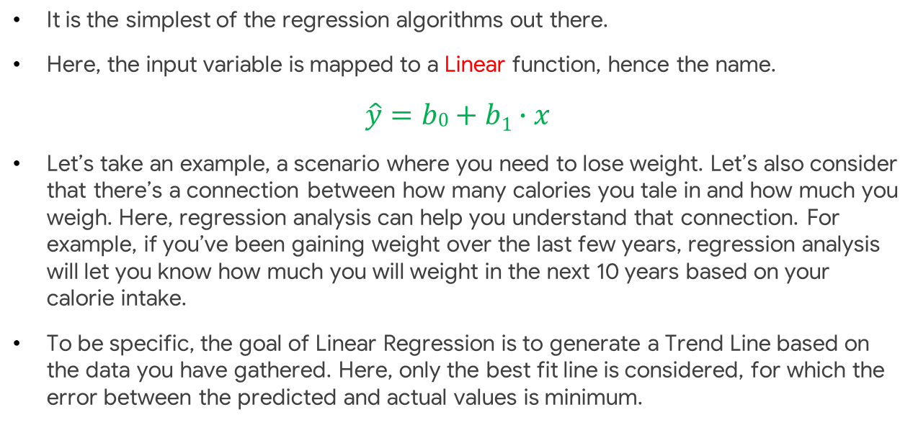
It is the simplest of the regression algorithms out there.
Here, the input variable is mapped to a Linear function, hence the name.
$$\hat{y}=b0+b1∙x$$
Let’s take an example, a scenario where you need to lose weight. Let’s also consider that there’s a connection between how many calories you tale in and how much you weigh. Here, regression analysis can help you understand that connection. For example, if you’ve been gaining weight over the last few years, regression analysis will let you know how much you will weight in the next 10 years based on your calorie intake.
To be specific, the goal of Linear Regression is to generate a Trend Line based on the data you have gathered. Here, only the best fit line is considered, for which the error between the predicted and actual values is minimum.

Slide 6
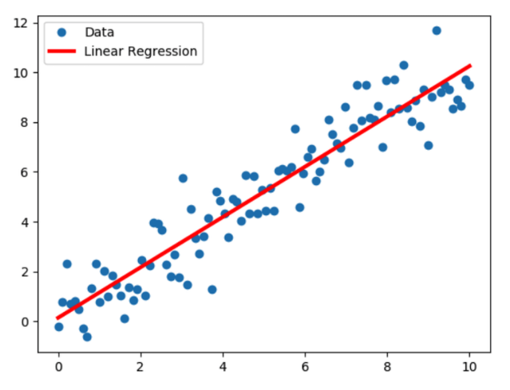
As depicted, the red line is the Regression Line we obtained and the blue dots are the Data Points from which the model is supposed to learn from.

Slide 7
Installation – cmd/terminal
The latest official release of Scikit-learn can be installed using pip:
pip install scikit-learn

Slide 8
Let’s get started with some hands-on experience with Linear Regression using scikit-learn
We’ll be using Google Colab for this.

Slide 9
Thank you!

